Slide 1


Web Development
Career in

Slide 2
Why Choose Web Development as Your Career Option?
1 Now Hiring! There Are Web Dev Jobs Available
2 A Great Income
3 You Can Work From Anywhere
4 You Can Work at an Awesome Tech Company
5 There Are Always Freelance Opportunities
6 It's Creative and Fun

Slide 3
What Does a Web Developer Do?
Web development and web design share many commonalities, but they differ in some key areas.
Web design deals with the front-end of a website, concerning itself with appearance and user experience. Web development, on the other hand, deals with building technical front-end and/or back-end code that informs site function.
Web developers may work exclusively on front-end code, back-end code, or both, and many modern jobs also require overlap into web design.
These professionals may work independently on a freelance basis or with marketing or IT departments.
Entry-level jobs often require only a small amount of formal education and training. As the internet continues to expand, so does the demand for talented web developers, making this career an attractive option.
The U.S. Bureau of Labor Statistics (BLS) projects that web development jobs will grow by 13% between 2018 and 2028 — much faster than the national average growth for all occupations.

Slide 4
Key Hard Skills
FRONTEND
HTML 5
CSS
JAVASCRIPT ( FRAMEWORK : ANGULAR JS )
( LIBRARY: REACT JS , JQUERY)
BACKEND
PHP ( FRAMEWORK : LARAVEL , CODEIGNITER )
( CMS : WORDPRESS , JOOMLA )
PYTHON ( FRAMEWORK : DJANGO , FLASK)
JAVA ( FRAMEWORK : )
C# ( FRAMEWORK : ASP .NET)
DATABASE
MYSQL
ORACLE
MONGODB
POSTGRES

Slide 5
Key Soft Skills
Multitasking
Self-motivation
Organizational Skills
Attention to Detail

Slide 6
Difference between Website and Web Application
Parameter | Web Application | Website
Created for | A web application is designed for interaction with the end user | A website mostly consists of static content. It is publicly accessible to all the visitors.
User interaction | In a web application, the user not only read the page content but also manipulate the restricted data. | A website provides visual & text content which user can view and read, but not affect it 's functioning.
Authentication | Web applications need authentication, as they offer a much broader scope of options than websites. | Authentication is not obligatory for informational websites. The user may ask to register to get a regular update or to access additional options. This features not available for the unregistered website visitors.
Task and Complexity | Web application functions are quite higher and complex compared to a website. | The website displays the collected data and information on a specific page.
Type of software | The web application development is part of the website. It is itself not a complete website. | The website is a complete product, which you access with the help of your browser.
Compilation | The site must be precompiled before deployment | The site doesn't need to be pre-compiled
Deployment | All changes require the entire project to be re-compiled and deployed. | Small changes never require a full re-compilation and deployment. You just need to update the HTML code.

Slide 7
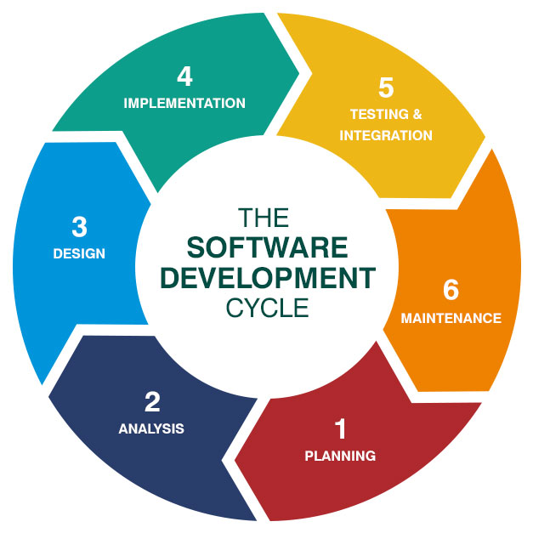
SDLC METHOD

